Slide 1
Parallel & Distributed Computing

Slide 2
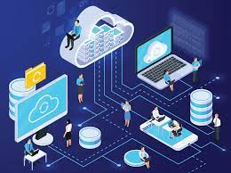
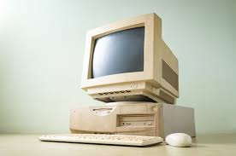

Computing
Computing is any goal-oriented activity requiring, benefiting from, or creating computing machinery. It includes the study and experimentation of algorithmic processes and development of both hardware and software. It has scientific, engineering, mathematical, technological and social aspects.

Slide 3
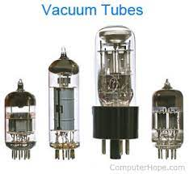
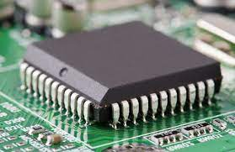
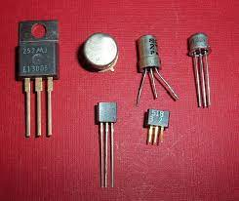
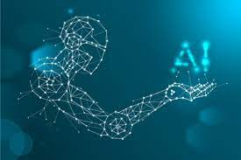
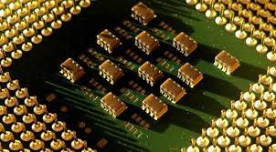
History of Computing
All the Computing generation & Evaluation
· Vacuum Tube
· Transistor
· Integrated Circuits
· Silicon Chips
· AI

Slide 4
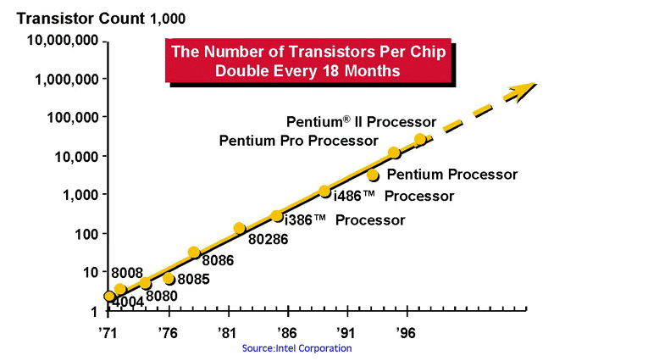
Moore’s Law
Moore's Law refers to Gordon Moore's perception that the number of transistors on a microchip doubles every two years, though the cost of computers is halved. Moore's Law states that we can
expect the speed and capability of our computers to increase every couple of years, and we will pay less for them

Slide 5
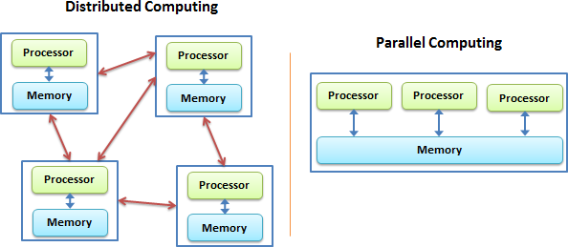
Fundamentals of Parallel & Distributed Computing
While both distributed computing and parallel systems are widely available these days, the main difference between these two is that a parallel computing system consists of multiple processors that communicate with each other using a shared memory, whereas a distributed computing system contains multiple processors connected by a communication network.
Email systems
Cloud file backup/storage systems
Electronic banking
Travel reservation systems
Distributed supercomputers

Slide 6
Distributed Computing | Parallel Computing
Typically consists of a network of computers | Mainly uses several processors
Used to share resources | Used for high performance
Used for consistency and availability | Used for concurrency
Designed to tolerate failures | Designed for massive calculations

Slide 7
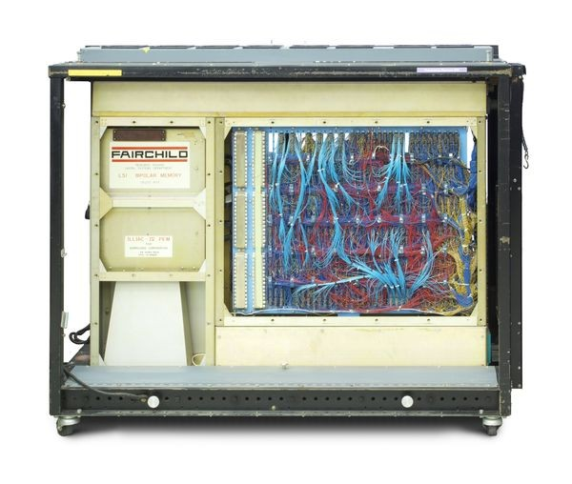
ILLIAC IV
This was the first “massively” parallel computer, built largely at the University of Illinois. The machine was developed in the 1960s with help from NASA and the U.S. Air Force. It had 64 processing elements capable of handling 131,072 bits at a time

Slide 8
Parallel & Serial Computing
A processing in which one task is completed at a time and all the tasks are run by the processor in a sequence. In real time example, people standing in a queue and waiting for a railway ticket. In this case, one person can get a ticket at a time.
In serial processing, same tasks are completed at the same time but in parallel processing completion time may vary.
In sequential processing, the load is high on single core processor and processor heats up quickly.
In serial processing data transfers in bit by bit form while In parallel processing data transfers in byte form i.e. in 8 bits form
Parallel processor is costly as compared to serial processor
Serial processing takes more time than parallel processor

Slide 9
Parallel & Serial Computing
Traditionally, software has been written for serial computation:
A problem is broken into a discrete series of instructions
Instructions are executed sequentially one after another
Executed on a single processor
Only one instruction may execute at any moment in time
In the simplest sense, parallel computing is the simultaneous use of multiple compute resources to solve a computational problem:
A problem is broken into discrete parts that can be solved concurrently
Each part is further broken down to a series of instructions
Instructions from each part execute simultaneously on different processors
An overall control/coordination mechanism is employed

Slide 10
Traditional Computing Types
Traditional computing merely refers to the concept of physical data centers and the dependence of the businesses that use these data centers for the sake of storing their digital assets and running a complete networking system for their day to day operations.
Day to day routine Operations.

Slide 11
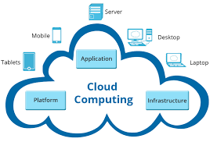
Cloud Computing
Cloud Computing is the combination of configurable components. Moreover, components like system resources and advanced services help deliver tasks using internet connections. Further, it runs tasks on third-party servers and enables the ability to access data from multiple locations. It also provides a cost-efficient solution and is more user-friendly. Above all, it offers more storage space, servers, and computing power to help the apps run efficiently and smoothly. Moreover, it only requires fast, eligible, and stable internet connections to execute tasks.
Examples: File Sharing + Data Storage: Dropbox.

Slide 12
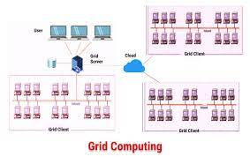
Grid Computing
Grid Computing is a process where computers and devices from various locations work on a single problem. Further, in this system clusters jointly execute given tasks. As a result, it applies resources from multiple computers and nodes. Therefore, it is a type of computing environment that utilizes several and scattered resources. Hence, these resources provide a functioning environment for executing a single task.

Slide 13
Personal Computing
A Personal Computing Environment includes a single machine. Moreover, it incorporates complete programs on a computer and performs it.
For example, machines like laptops, mobiles, printers, etc are a part of the Personal Computing Environment. As a result, this type of computing environment is for single users to run tasks at home or offices.

Slide 14
Time Sharing
A Time-Sharing Computing Environment enables multiple users to share a system concurrently. Furthermore, it allows various time slots for various users and processes. Hence, the processor switches rapidly and changes users according to their slots.
For example, Windows 95 and its later versions, Unix, IOS, Linux OS all run on the time-sharing computing environment

Slide 15
Client Server
Client-Server Computing is a type of environment that incorporates two machines. Therefore, it includes a client machine and a server machine. Sometimes, the same machine serves as the client and the server. Subsequently, a client requests a resource or service and a server provides the same. Moreover, a server provides a resource or service to multiple clients simultaneously. Hence, the communication takes place using a computer network.
Categorization of Client-Server Computing Environment is into two types:
Computer Server: It provides the interface to the clients. Hence, it helps communicate requests to execute tasks.
Meanwhile, the server performs the task and responds with the outcome.
File-Server: The environment provides a file-system interface. Therefore, allowing clients to create, update, read, and delete files.

Slide 16
Peer to Peer
Peer-to-Peer Computing is a type of environment similar to a Distributed type of Computing Environment. That is to say, there are no differences between clients and servers in this type of computing environment.
P2P provides an advantage over traditional client-server environments. That is to say, it provides services using several nodes throughout the network.

Slide 17
Mobile Computing
Mobile Computing refers to the type of environment that runs tasks on smartphones and tablets. Hence, it is computing on portable and lightweight devices.
Although, compared to other devices, mobile systems lack screen size, memory capacity, and other traditional functionalities. However, it does provide remote access to multiple services.
Today, mobile computing environments consist of multiple functions. Hence, it offers services as good as any other traditional device. Moreover, the two main operating systems that dominate this market are Apple iOS and Google Android.

Slide 18
Cluster Computing
In this type of computing environment, clusters execute tasks. Cluster Computing allows clusters to work as a set of loosely or tightly connected computers.
Consequently, it is viewed as a single system and executes tasks parallelly. Hence, it is also similar to a parallel type of computing environment. As a result, the cluster computing environment prefers cluster-aware applications
The clustered computing environment is similar to parallel computing environment as they both have multiple CPUs. However a major difference is that clustered systems are created by two or more individual computer systems merged together which then work parallel to each other.

Slide 19
Pros & Cons of Parallel & Distributed Computing
The advantages of parallel computing are that computers can execute code more efficiently, which can save time and money by sorting through “big data” faster than ever.
Parallel programming can also solve more complex problems, bringing more resources to the table.
Cons: Programming to target Parallel architecture is a bit difficult but with proper understanding and practice, you are good to go.
Extra Cost
Power Consumptions & Better cooling technologies are required in case of clusters.

